Slide 1
Technical Exam
Prepared by: Joan Marie Vale

Slide 2
Project Overview
Objective:
Build an AI-powered customer support system that understands customer sentiment and responds intelligently

Slide 3
The Models
RoBERTa: Robustly Optimized BERT (94% accuracy).
Trained on Twitter data for casual language understanding.
Groq Llama 3: 10-20x faster than traditional GPU inference.
Generates human-like reasoning for support decisions.

Slide 4
System Architecture
Sentiment API
Model: Cardiff NLP Twitter RoBERTa
Port: 8000
Function: Classifies text sentiment
Agent API
Port: 8001
Function: Orchestrates sentiment + reasoning
Decision Logic: Rules-based routing

Slide 5
System Architecture
Chat UI
Framework: Streamlit
Port: 8501
Function: Interactive interface
Data Flow:
User Message → Sentiment API → Agent Logic → Groq LLM → Response

Slide 6
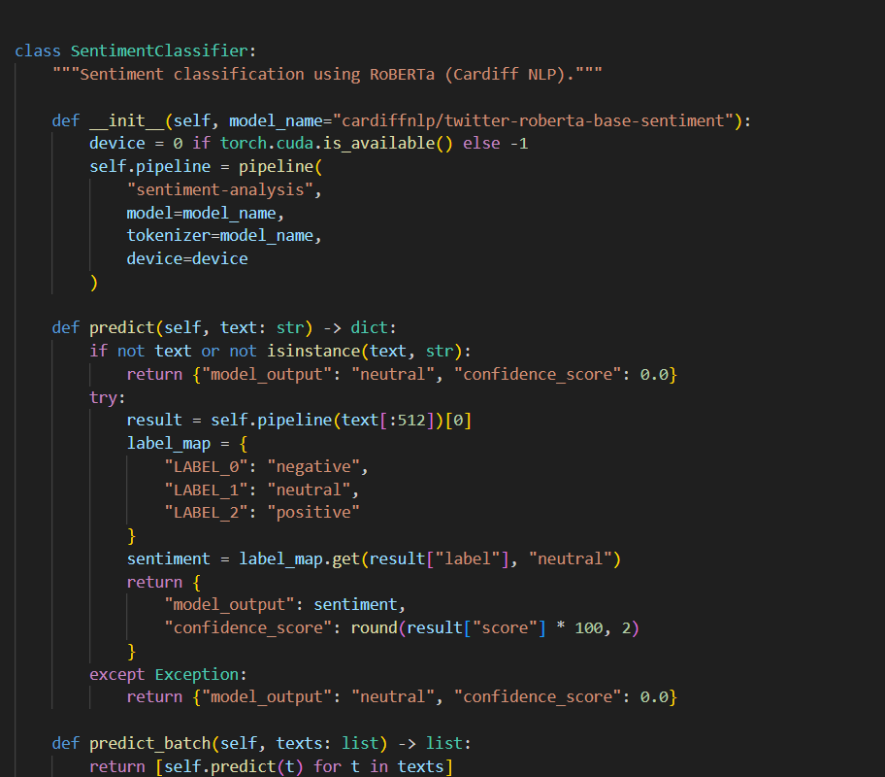
Code: Sentiment classifier
Key Points: Loads RoBERTa model, truncates to 512 tokens, returns sentiment + confidence

Slide 7
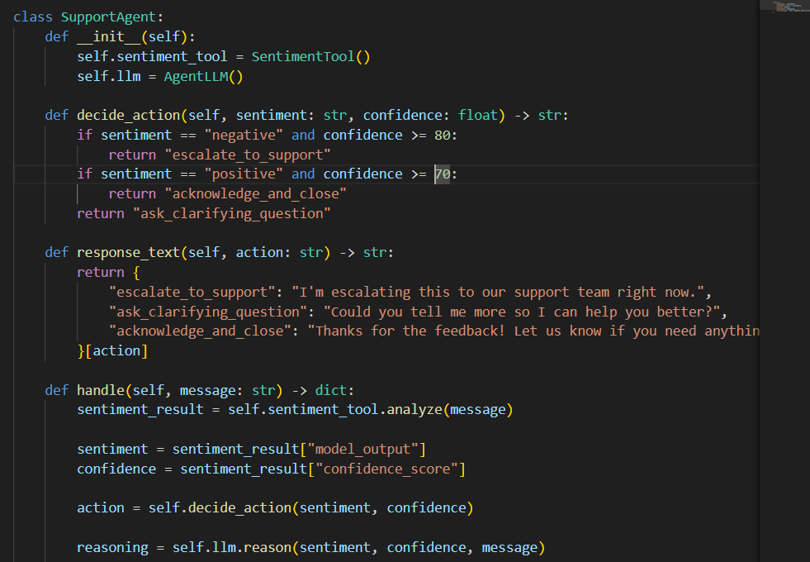
Code: Agent Decision Logic
Decision Rules: Negative (≥80%) → Escalate | Positive (≥70%) → Acknowledge | Else → Ask

Slide 8
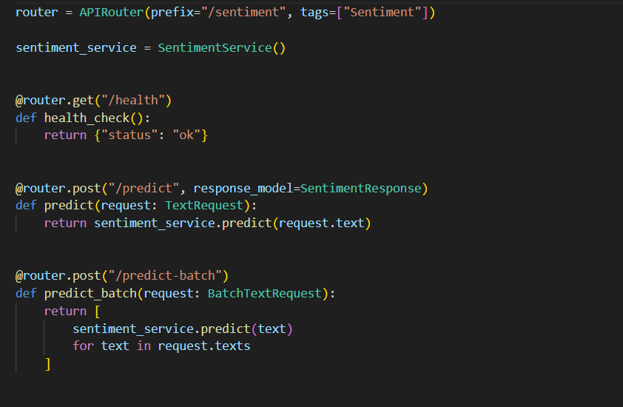
Code: API Endpoints
REST Endpoints: FastAPI handles HTTP requests, processes through pipeline, returns JSON

Slide 9
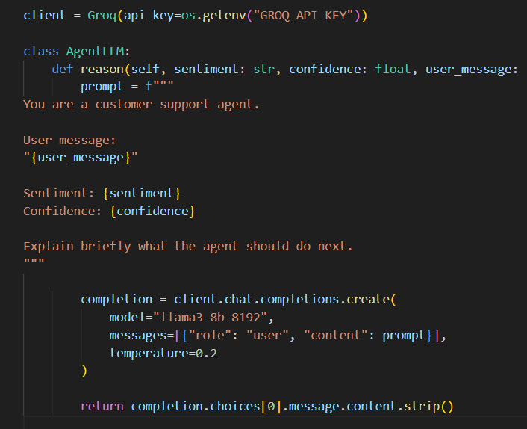
Code: Groq LLM Reasoning
Groq Integration: Sends sentiment context, gets reasoning via API

Slide 10
Complete Data Flow
Input: 'I love this product!'
1. Sentiment: Positive (Confidence: 95%)
2. Action: 'acknowledge_and_close'
3. LLM: 'Customer is satisfied. Close and thank them.'
Total Latency: ~500ms

Slide 11
Deployment (Docker)
1. Clone repository from GitHub.
2. Configure .env with GROQ_API_KEY.
3. Run 'docker-compose up --build'.
4. Access UI via localhost:8501.

Slide 12
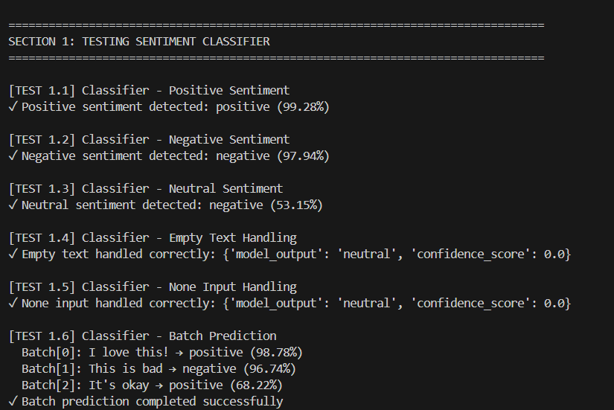
Test Case Results

Slide 13
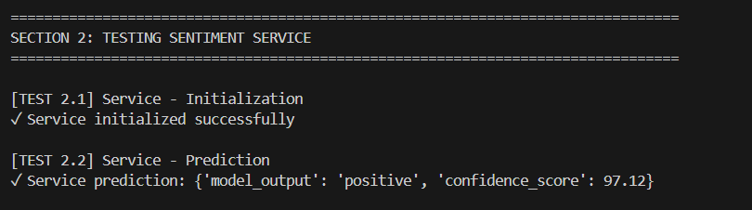
Test Case Results

Slide 14
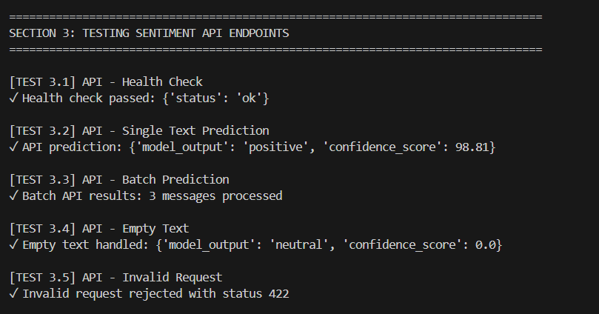
Test Case Results

Slide 15
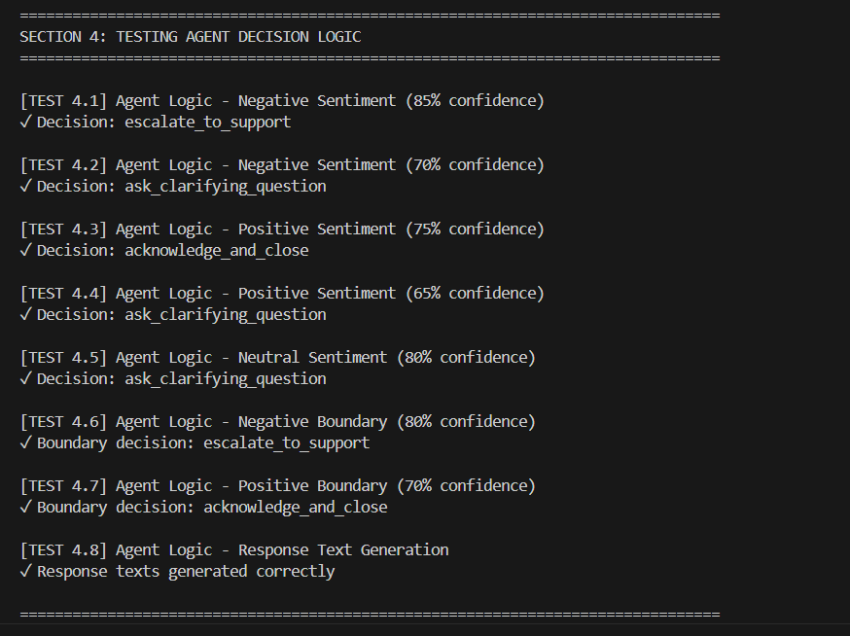
Test Case Results

Slide 16
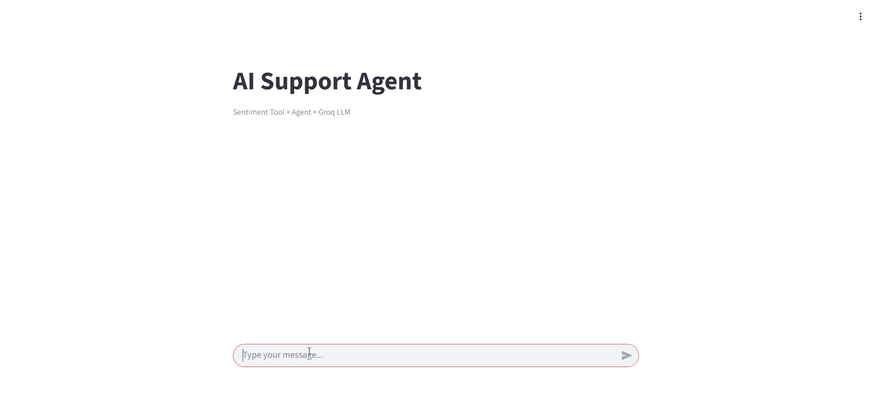
DEMO

Slide 17
For the model. It was deprecated. I’ve tried other model but it gives me the same error. If I will be given a time I can use ollama gemma or mistral model

